Slide 1
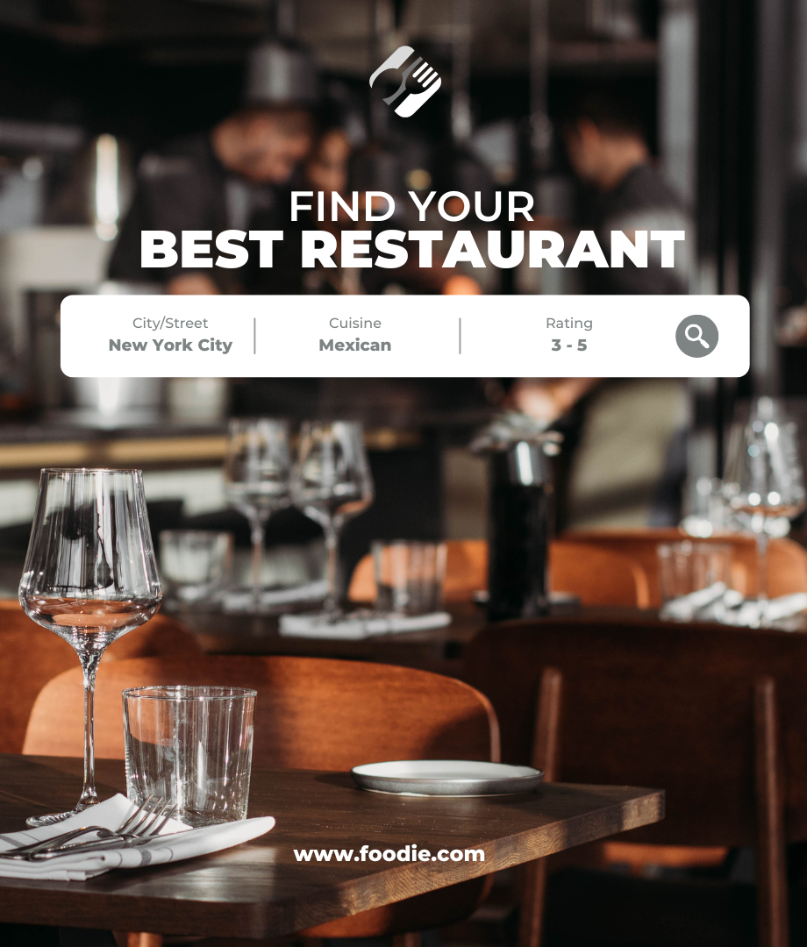
Food.com
Go-To Restaurant Integrated Platform
From swipe to bite!
APAN 5400 Managing Data
GROUP 3
Sansinee, Sipprang, Suchakrey, Viviane, Yuefan

Slide 2





Background
Don’t Know
What to Eat
Search for
Various Information
No Interacted
Recommendation
Current App’s Pain Points
Incomplete Information:
Users must switch between apps to find reviews, menu, pricing, atmosphere and to make reservations.
No Recommendation:
Platforms do not offer any restaurant recommendations to solve the problem.
Inconvenience:
Decision-making process is fragmented, inefficient, and lacks relevance.

Slide 3


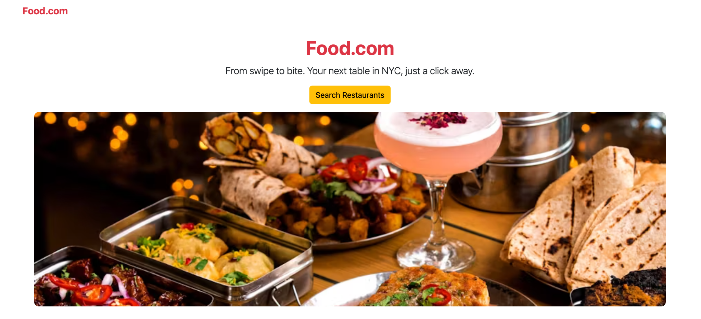

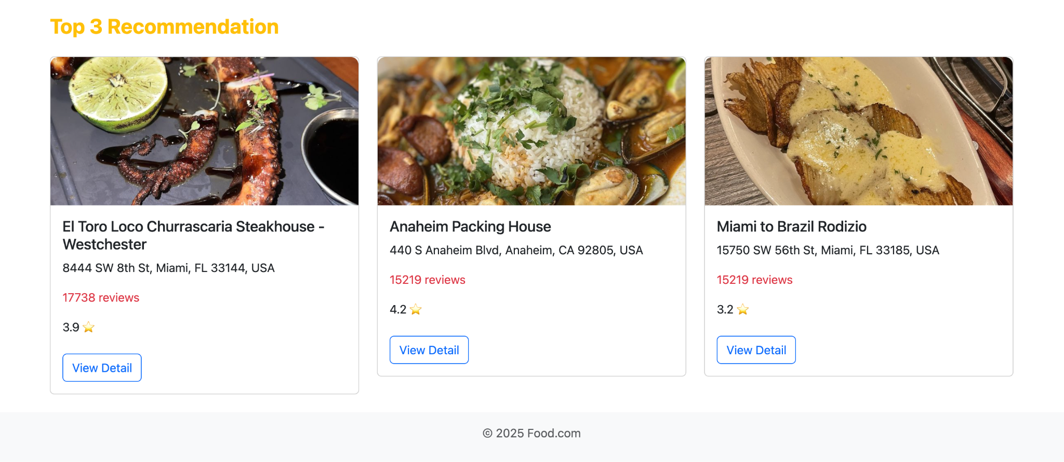
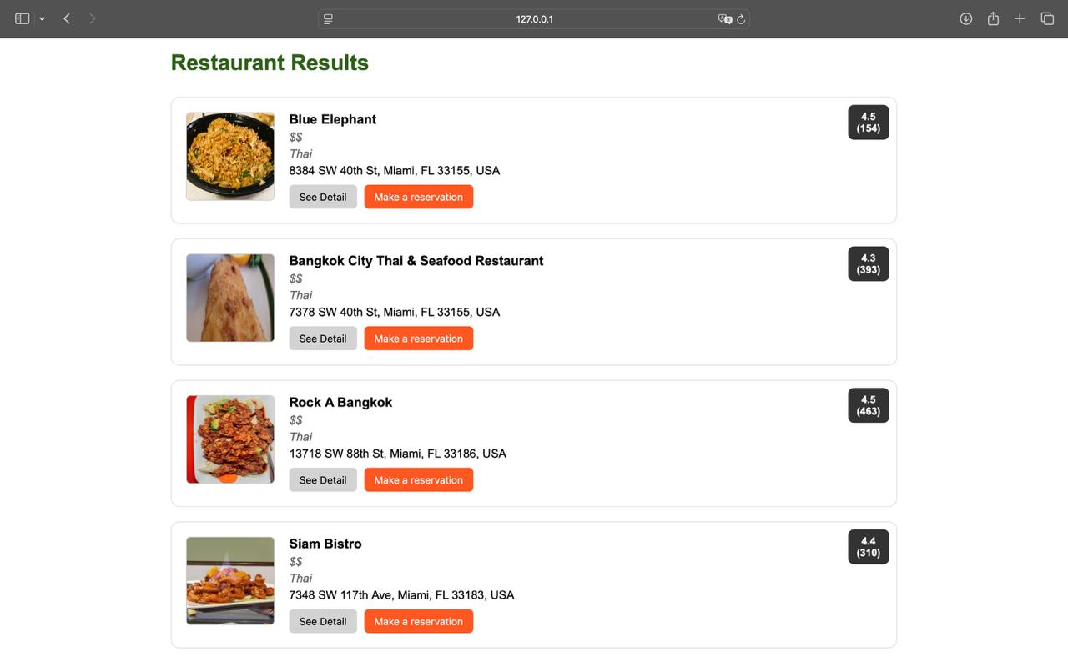
Solution
All-in-One
Information Interface
How We Solve it:
Complete Information:
Include all the information with reviews, menu, pricing, and keywords search engine. Users can easily find the restaurants atmosphere based on the reviews.
Combining Searching & Reservation Functions in one app:
Possessing concrete dining information and decision-making process in one platform.
Interacted Recommendation:
Recommend the top 3 most reviewed restaurants for the users.

Slide 4




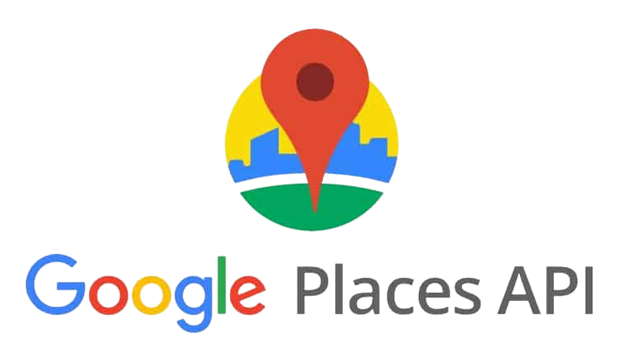

Data Source
How to get data
What does the data look like?
City Names – Yelp API – Places API – Combine Data
Field | Source from APIs | Notes
 |  | Restaurant name
 |  | Includes street, city, zip
 |  | Latitude and longitude
 |  | Yelp rating from users (1–5)
 |  | Total number of Yelp reviews
 |  | Estimated price level
 |  | Unique ID on Google Maps
 |  | Google-formatted address
 |  | Official phone number
 |  | Restaurant’s actual website
 |  | Weekly opening hours
 |  | Google user rating (1–5)
 |  | Total number of reviews
 |  | Top 3 recent user reviews
name
Step 1:
location
List of Major Cities Names in the USA
coordinates
rating
Step 2:
review_count
Major City names will be used to collect restaurant data from Yelp API
price
google_place_id
google_address
Step 3:
google_phone
Yelp’s data will be used to search and extract additional details via Google Places API
google_website
google_opening_hours
google_rating
Step 4:
google_review_count
Data from Yelp and Google API will be combined as Final Raw Data
google_top_reviews

Slide 5










Technology Rationale
Data Source
Database
Data Query
2
1
4
search
3
reservation
1
2
4
We plan to retrieve restaurant review data from Yelp and Google Reviews using API services and the Python requests library.
Since we have multiple data sources, We will store our data in a graph database using Neo4j to enable efficient location-based and category searches.
We will use Flask to build a web application for searching and reserving restaurants.
3
We will store our reservation data in tables within a PostgreSQL database, allowing the restaurant to access and view it.

Slide 6


Applicable Data Governance Policies
Data Privacy & Security
We ensure that our use of Yelp and Google Maps APIs aligns with their terms of service.
We store only necessary data and avoid keeping personal information beyond the required duration.
Data Accuracy & Integrity
We pulled data from APIs at the beginning of moth to prevent outdated information.
We implement checks to remove duplicate restaurants and reviews.

Slide 7


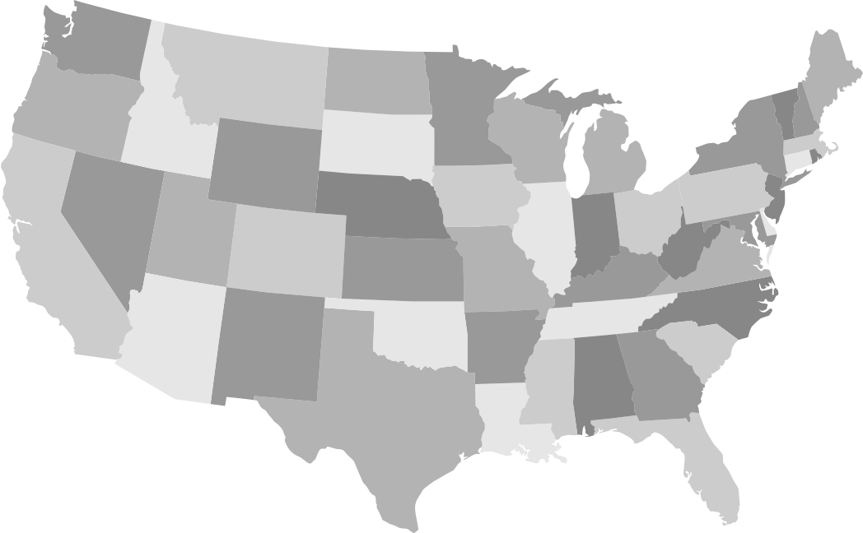

Scalability and Cost Challenges
Scalability
Our platform currently provides restaurant recommendations to users in major cities using free APIs from Yelp and Google Maps. However, these APIs have usage limits. Expanding to other U.S. cities or international locations will require handling more API calls, raising potential performance and cost concerns as the platform scales.
To handle more users and data smoothly, we may need to use cloud services. These platforms let us automatically adjust computing power based on demand, helping keep the website fast and reliable. However, this transition introduces additional costs.
Cost Implications
While we use free API tiers for now, scaling to additional cities or countries will introduce costs.
Yelp’s paid Fusion API plan starts at $299 per 1,000 API calls per month after a 30-day free trial with 100 calls per day.
Google Maps uses a pay-as-you-go model, with charges based on requests. As the user base and API calls grow, the cost will increase accordingly.
Cloud platforms use pay-as-you-go pricing, so costs increase with usage. We may use services like Google Cloud for database hosting and managing high traffic.
Google Cloud SQL: Starts at $0.017 per hour for the smallest instance, with additional charges for backups and storage.
Google Cloud Storage: $0.026 per GB per month.

Slide 8
Conclusion
Future Recommendations
Foodie.Com combines Yelp and Google Maps APIs to help users in NYC and other major cities discover restaurants that match their needs. The platform delivers relevant, keyword-based suggestions with an intuitive interface.
Expand to More Cities
Add Personalization
Cloud Scalability
User Accounts
Scale beyond NYC and major cities with higher API quotas.
Use user behavior and sentiment for tailored results.
Move to cloud platforms to support growing traffic.
Allow users to create profiles and save favorites and get custom suggestions.

Slide 9

Thank You!
Food.com
GROUP 3
Sansinee, Sipprang, Suchakrey, Viviane, Yuefan

Slide 10
Appendix
Notes:
Landing Page
"Welcome to our restaurant reservation website! On the landing page, you can see a search bar at the top. Below, we show the top three recommended restaurants for you. You can scroll and click on any of them to learn more."
Search, Filter, and Results
"Let’s try searching for a restaurant. I’ll type in ‘Italian food’ and click the search button. Now, you can see a list of restaurants that match our search. If you want, you can also use filters—like price, rating, or location—to narrow down the results. Let’s click on one restaurant to see more details."
Restaurant Details
"Here, you can see all the details about the restaurant:
The name and address
A link to their website
Their menu
And customer reviews If you like this place, you can make a reservation right here."
Reservation (with PostgreSQL Update)
"Let’s make a reservation. I’ll choose the date and time, and enter my name and contact details. When I click ‘Reserve’, our system will update the database:
It adds my information to the customer table
It updates the restaurant table if needed
And it creates a new entry in the reservation table Now, I see a confirmation message."
Confirm
"Here’s my reservation confirmation. It shows my booking details and a confirmation number. If I need to, I can cancel my reservation from here."
Cancel
"Let’s try cancelling the reservation. I click the ‘Cancel’ button. The system will now delete my reservation from the reservation table in the database. I see a message that my reservation has been cancelled."
Back to Home Page
"Finally, I click the home button to go back to the landing page. Now, I can search for another restaurant or make a new reservation.

Slide 11
Website Concept: Landing Page
Restaurant Search Engine
Users can search specific restaurants information under search function.
Top 3 Recommendations
Recommend the top 3 most reviewed restaurants to help users decide what to eat.
neo4j
Notes:
Let’s talk about our core website building concepts. Besides these pretty designs, there are two major methods, post and get, that are used for its core functionality.
On the central top of our homepage, there is a search bar which links to the searching page allowing users to search for desired restaurants. We also put top reviewed restaurants on the homepage for customers to view if they have trouble deciding where to eat.

Slide 12
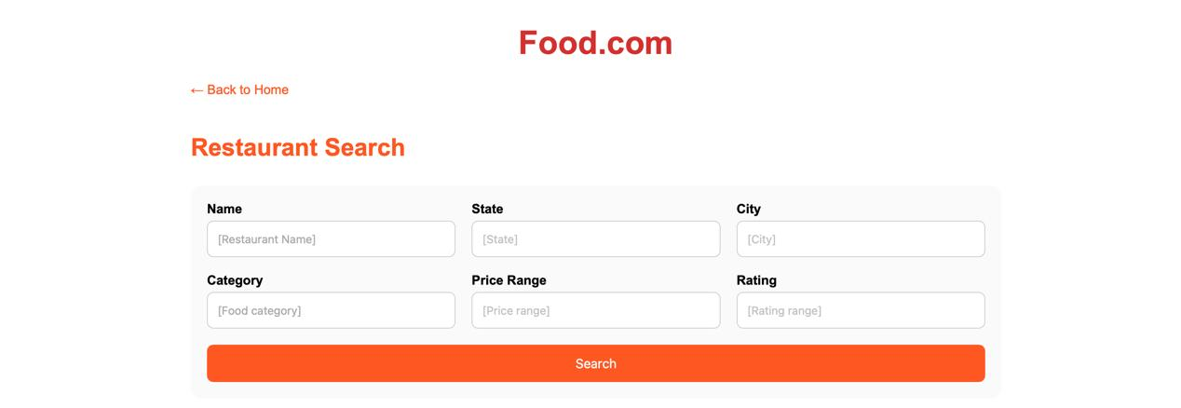
Website Concept: Searching Page
Restaurant Search Engine
Based on customer needs, users can perform more precise searches by restaurant name, location, cuisine type, price range, and ratings.
neo4j
Restaurant Result
Users can scroll down the result page to find out the detailed information and then make the reservation.
neo4j
Notes:
Once the search bar directs users to our searching page, the advanced search functions allow customers to select their desired restaurant attributes for detailed searching. Post function on the backend will collect users’ input and then use neo4j functions to get restaurants that qualify with all user requests.

Slide 13
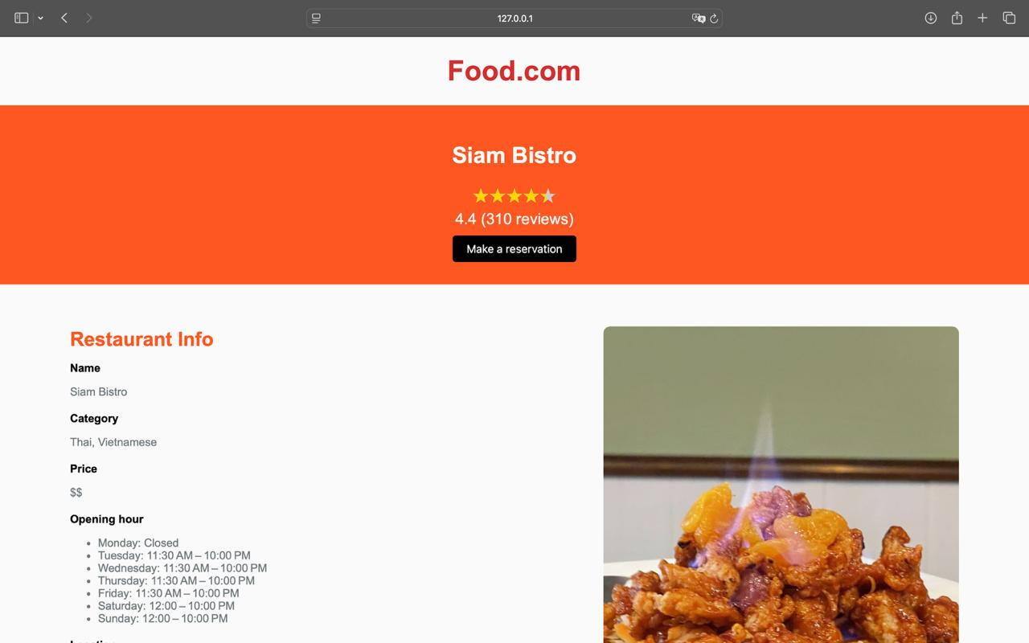
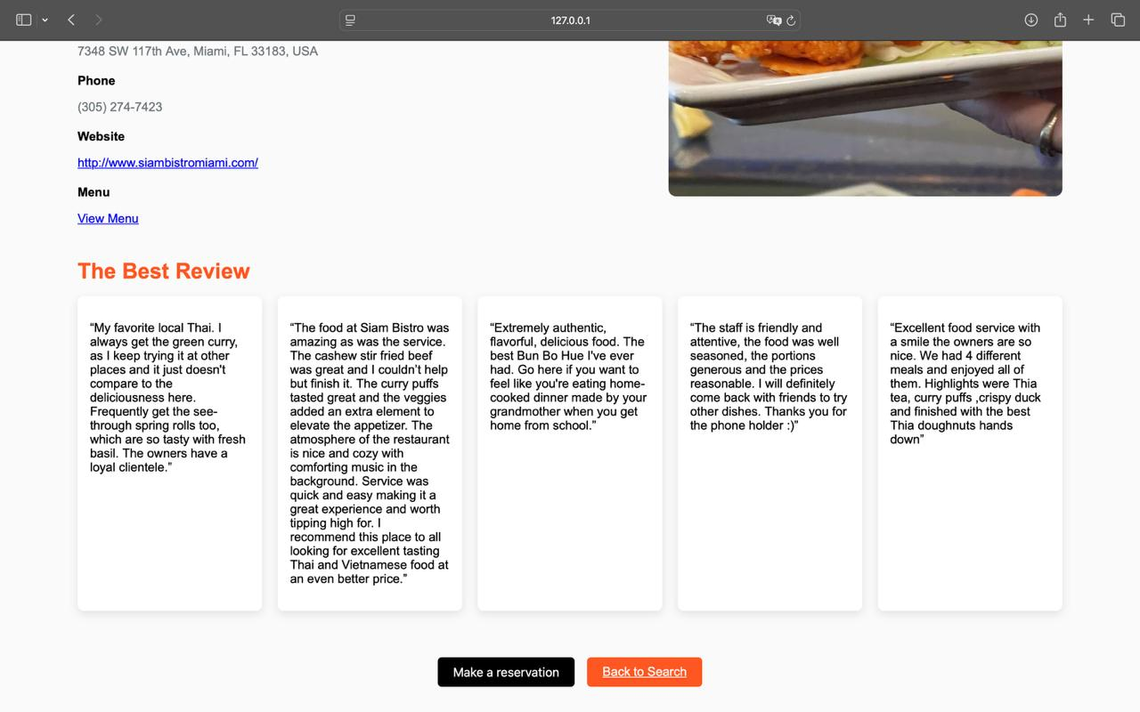
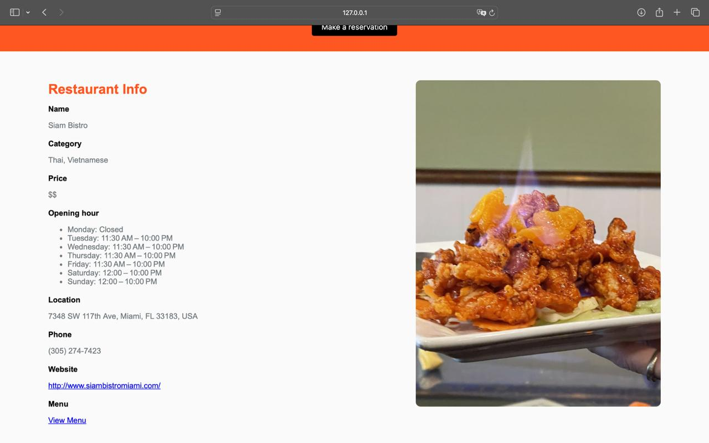
Website Concept: Detail Page
Detail Information
The Best Review
Showing restaurant information with ratings, prices, opening hour, location, phone number, website, menu, and pictures.
Users can see the reviews by other customers, and decide if they want to make a reservation.
neo4j
neo4j
Notes:
There are two options for users to continue to move forward. The first one shows restaurant details. Detail page uses the get function to retrieve all stored information of the restaurant's current status for display. Neo4j functions here in the backend workspace do the job of retrieving all data. Customers then get to know the operating hours, top reviews, and other details of that restaurant.

Slide 14
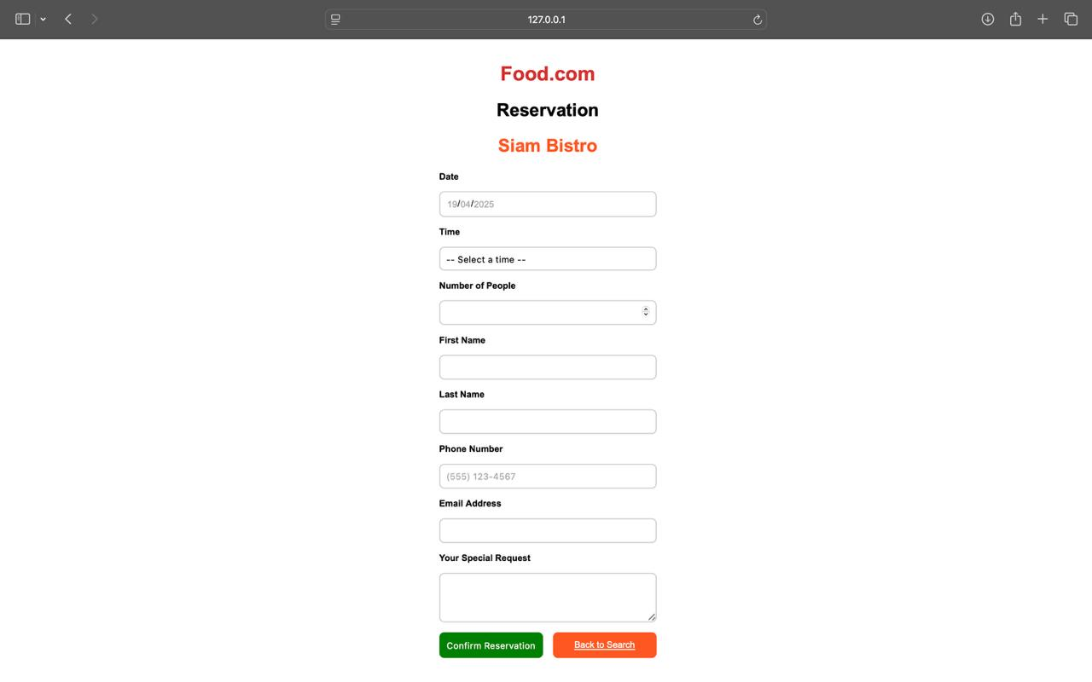
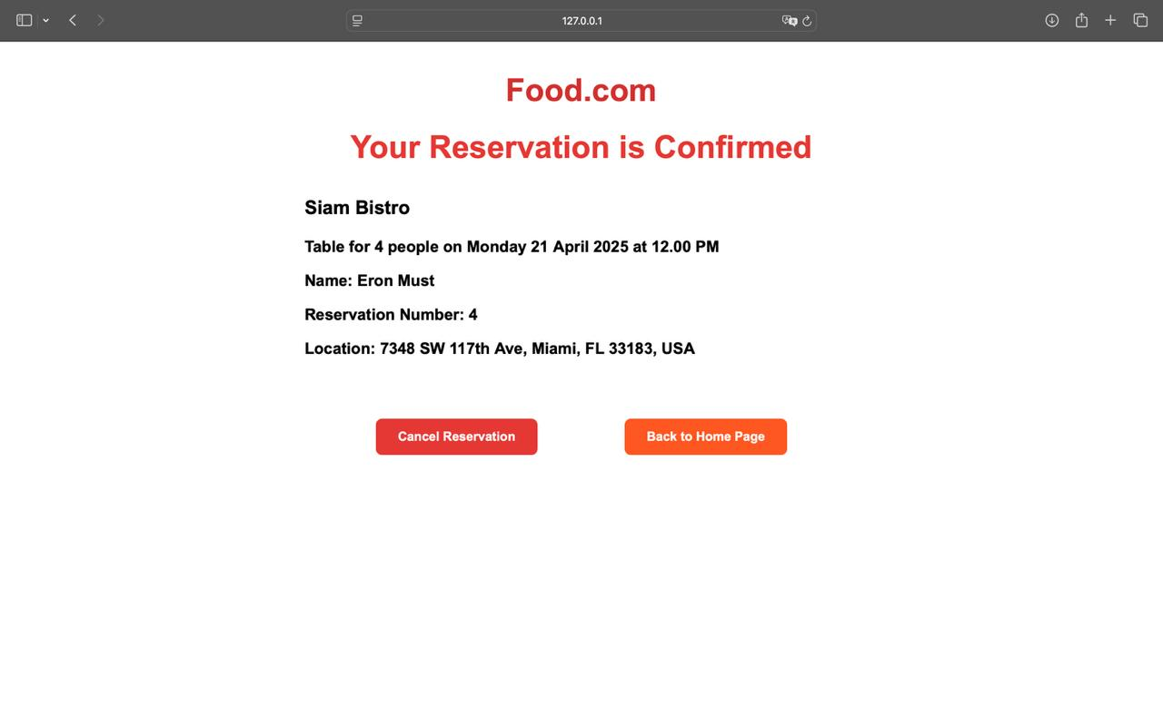
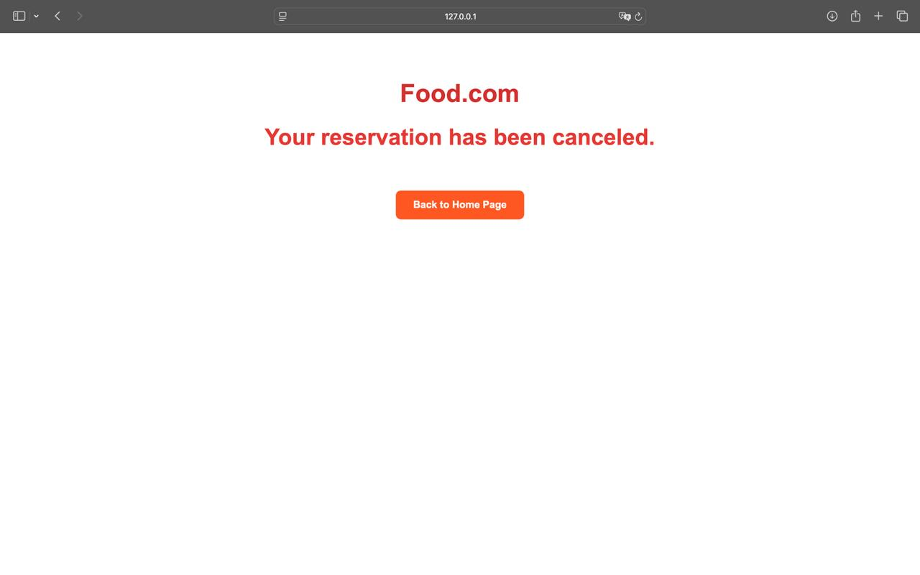
Website Concept: Reservation & Confirm
Make Reservation
Users can ultimately make reservation and check the confirmation information.
Postgres & SQL
Customer do not need to switch websites to think, search and reserve. Food.com solve all the problem in one integrated platform.
Notes:
If the customer intends to go after viewing all details, the second button “make a reservation” will take customers to the reservation page. From here customers may input their personal information and desired date and time for booking a table. Once submitted, food.com will store the customer's request in PostgreSQL and show a confirmation when booking is successful. Users can always cancel their reservation if they decide not to go, which minimizes the chance of creating further confusions.
The rationale that we create this platform model is that users do not need to switch websites to decide what to eat, search for specific restaurants and make reservations. Our website Food.com solve all the problem in one integrated platform.

